Slide 1
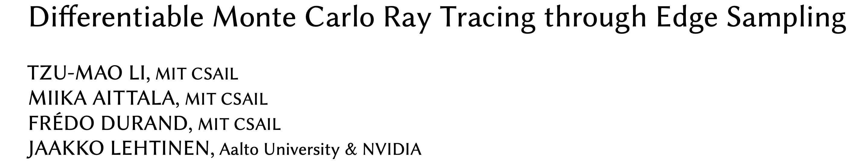
CSC2457 3D & Geometric Deep Learning
Date: 16 Feb. 2021
Presenter: Jingkang Wang
Instructor: Animesh Garg

Slide 2


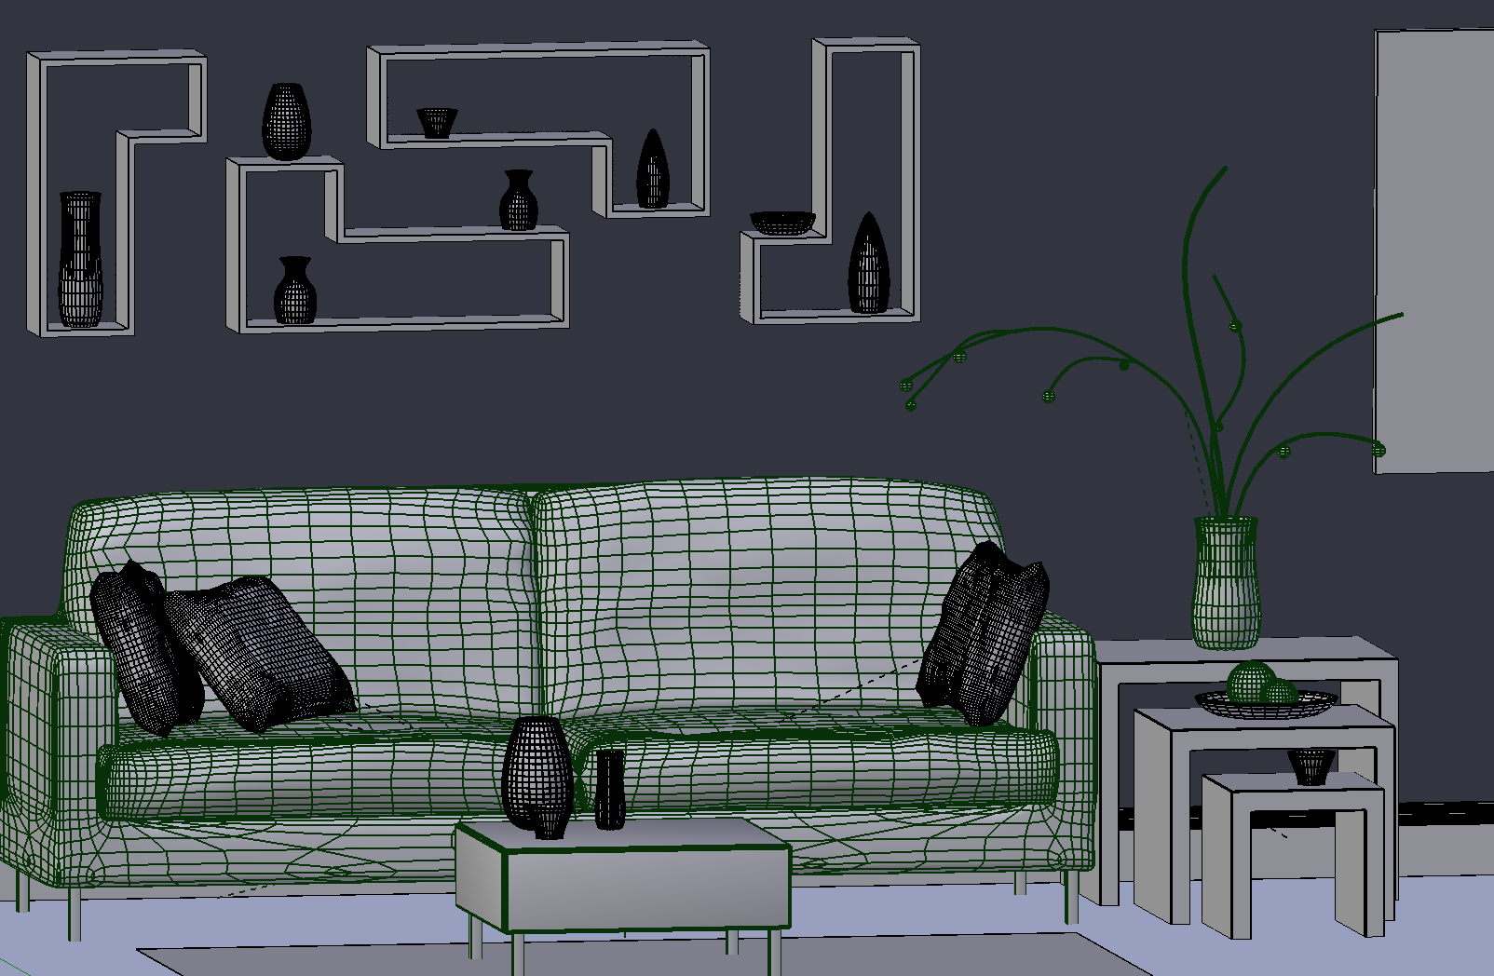
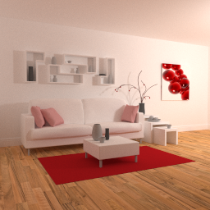
Differentiable Rendering is Important!
The ability of calculating gradients are crucial to optimization
(a) inverse problems, (b) deep learning
Cameras
Geometry
Lights
Material
rendering
Inverse
rendering
neural
network
neural
network
3D scene
image
Notes:
These days we know pretty well on how to render a photorealistic image from a 3D scene consists of camera, geometry, material and light source information. We denote the collection these variables as capital phi.
However, going backward is much more difficult. Given one or more images, can we generate a 3D scene, such that when we render the scene, we get the images back?
Inverse rendering is important since we often want to reconstruct 3D scene from images and re-render them, say for robotics, virtual reality or lighting design in movies.
Also, both direct and reverse rendering have great potential for deep learning so that the neural network can understand the 3D information of the images. For this, we need to compute the rendering gradient w.r.t Phi.

Slide 3
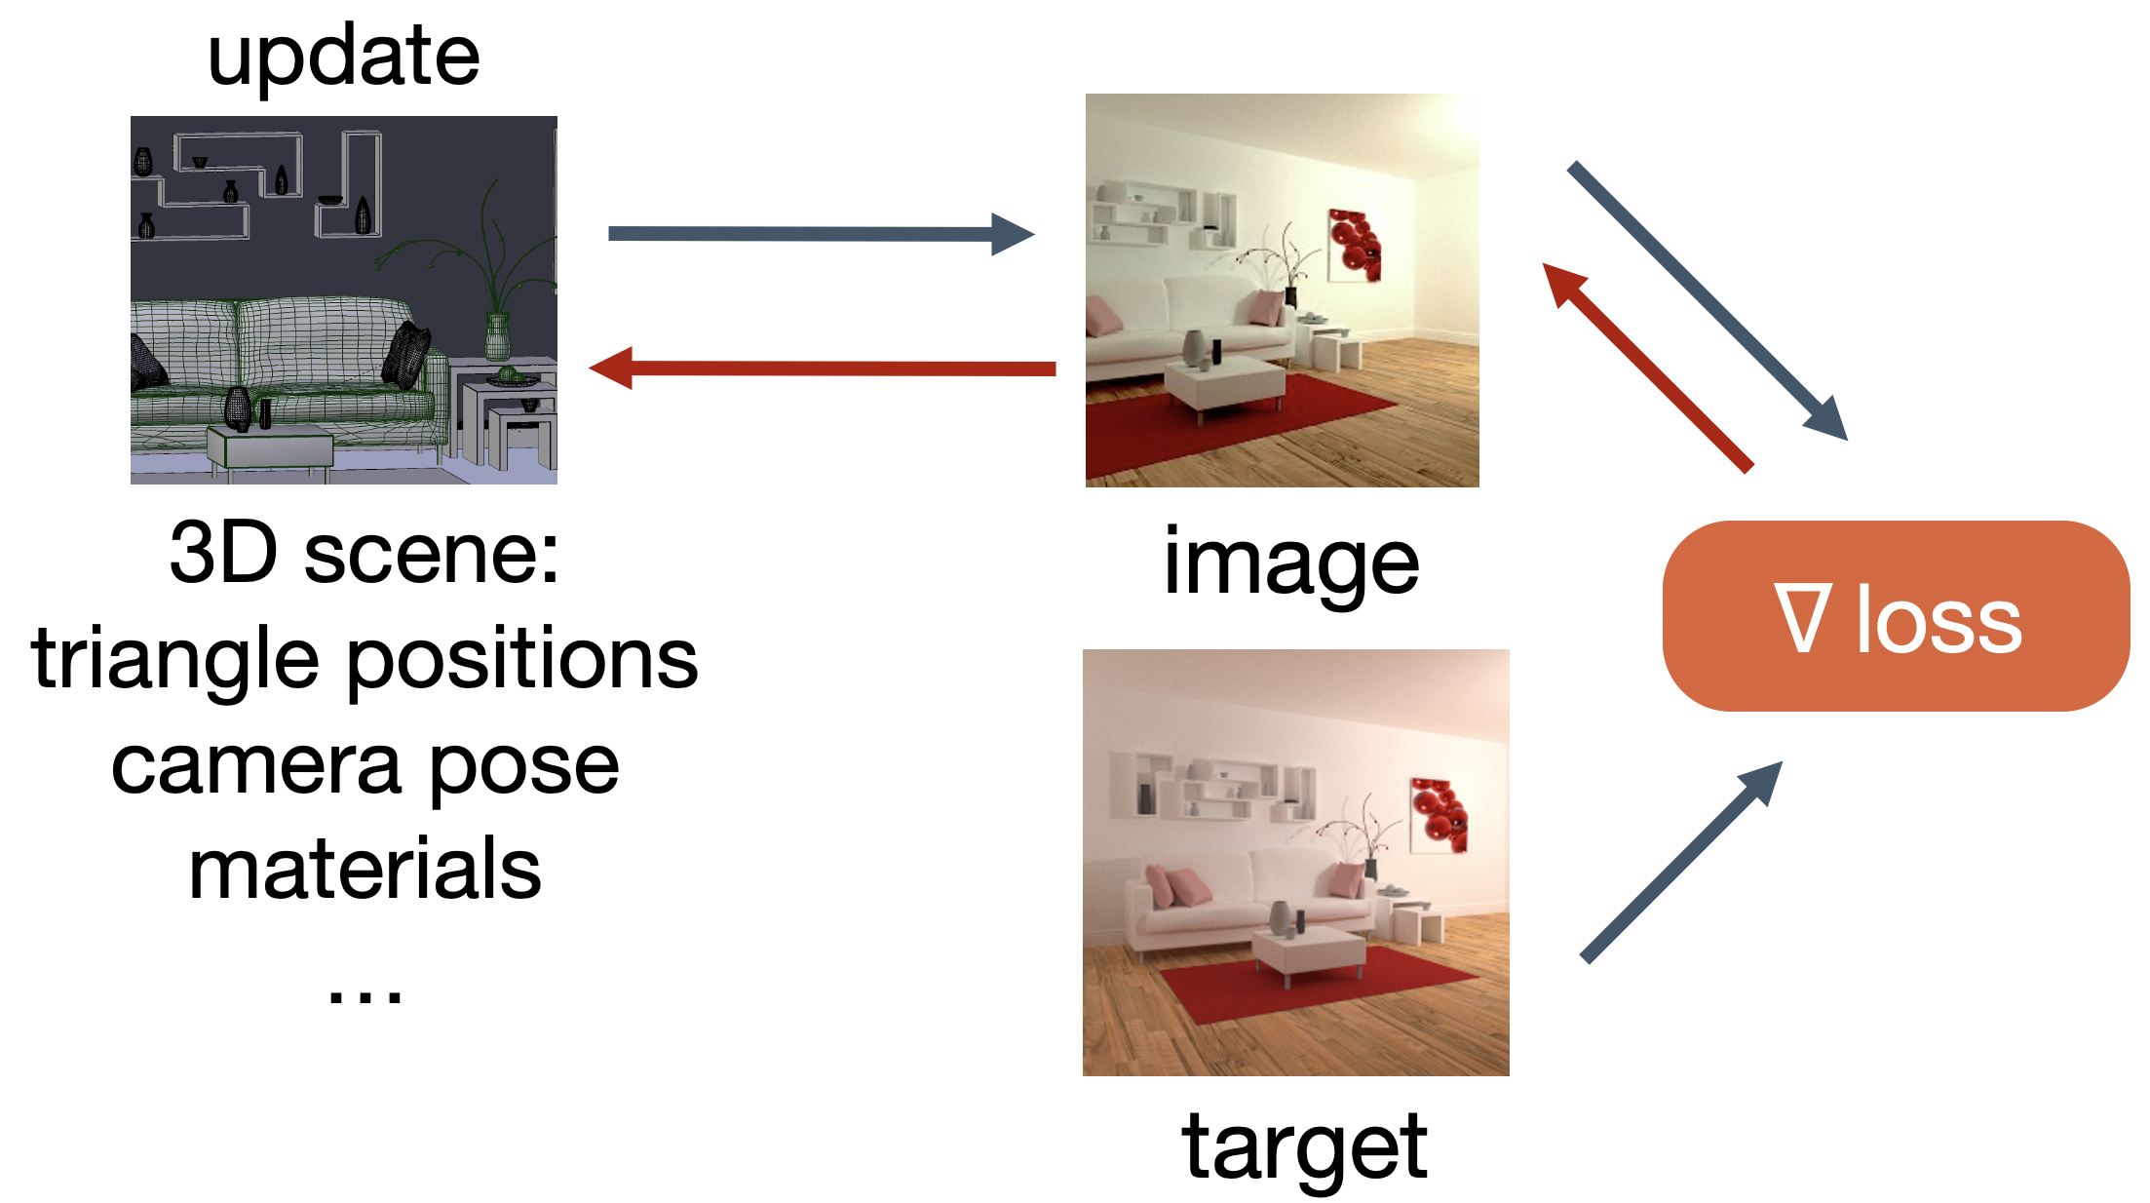
Differentiable Rendering is Important!
Render and compare approach
distance to target
Optimize scenes via
differentiable renderer
source
Gradients?
target
3D scene
Notes:
Here is a more concrete example for inverse rendering. One way to solve this problem is what I call the render and compare approach, where you render a 3D scene, and compare with the target. Then minimizes the distance between your output and the target and update the 3D scene using the gradients of a loss function.
To achieve this, we need a differentiable renderer such that we could optimize using gradient and update the scene parameters.

Slide 4
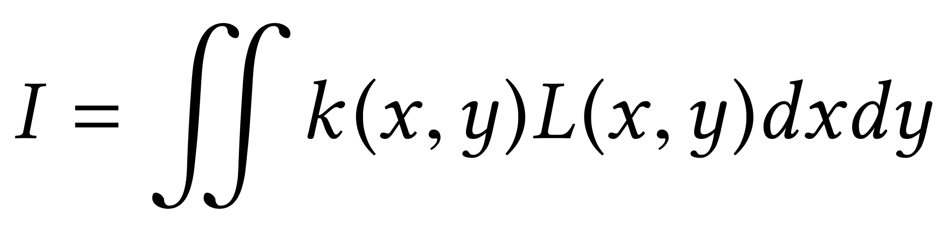
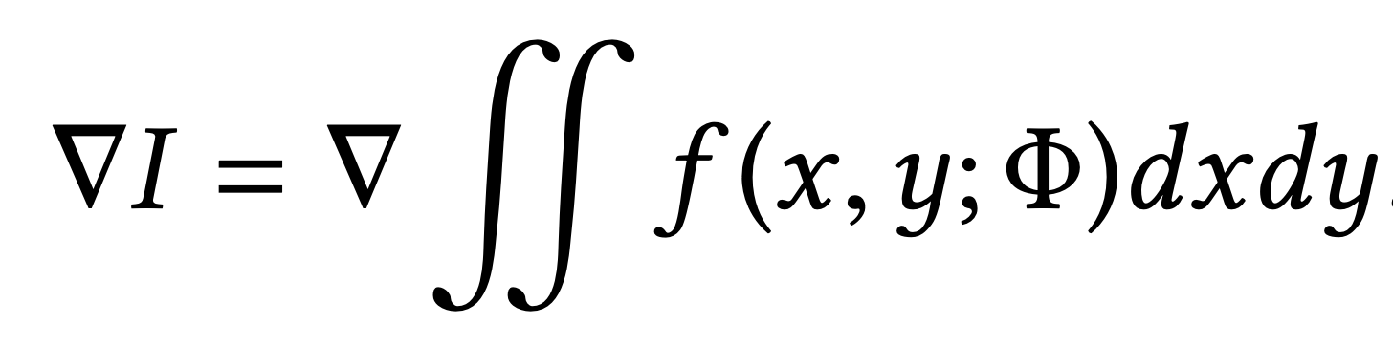
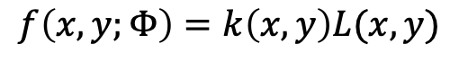
Differentiable Rendering is Important!
Computing the gradient of rendering is challenging!
Rendering integral includes visibility terms that are not differentiable
Pixel filter
Radiance (another integral)
Scene function:
$$f\left(x,y;Φ\right)=k\left(x, y\right)L(x,y)$$
rendered image
Notes:
However, unfortunately, computing the gradient of rendering is challenging. In general, this is because the rendering integral includes visibility terms that are not differentiable. For example, taking one pixel from a rendered image, we know the color can be calculated from the rendering equation, where k(x, y) denotes the 2D pixel filter and L(x, y) denotes a radiance. The radiance itself can be another integral that integrates over light sources. The integral usually does not have a closed-form solution in general, people usually rely on Monte Carlo to estimate the pixel value I.
Moreover, we cannot take the naive approach of applying the same Monte Carlo sampler to estimate the gradient ∇I, since the scene function f is not necessarily differentiable with respect to the scene parameters. I will elaborate this point later.

Slide 5
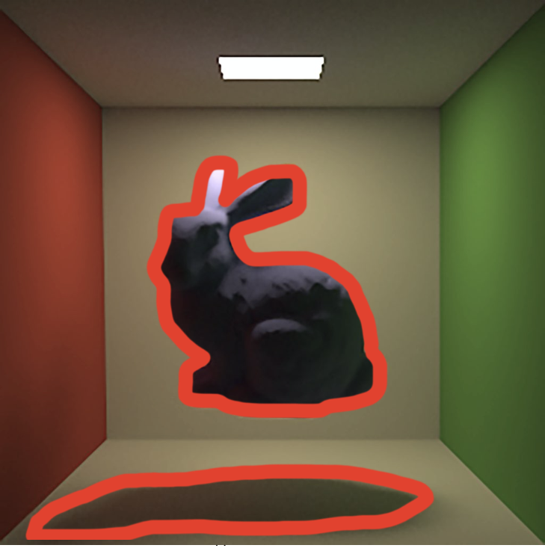
Differentiable Rendering is Challenging!
Challenge: both primary and secondary visibility matter
Notes:
So far we know that it is difficult to calculate the gradients w.r.t the scene parameters and the major challenge of differentiable rendering is the visibility.
Here is an example. If you move the bunny a little bit, some pixels will now see more bunny, and some will see the walls a bit more.
Likewise the shadow of the bunny will also move a little bit.

Slide 6
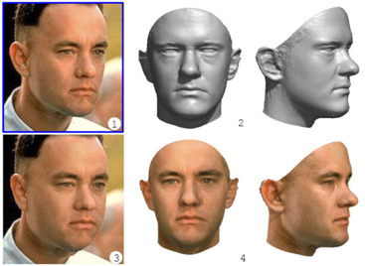
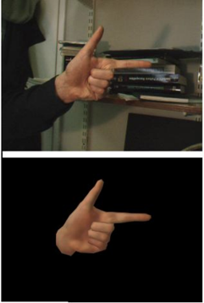
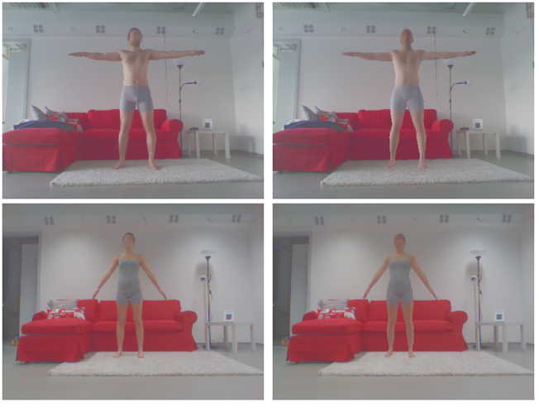
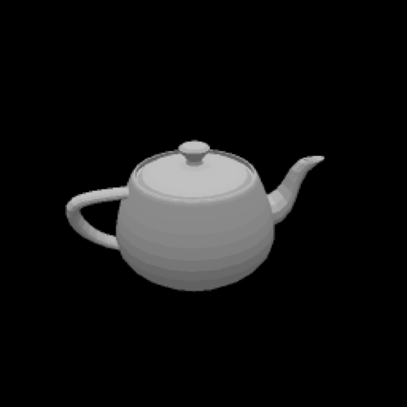
Contributions
Previous works
Differentiable rendering that targets specific cases (faces, hands, etc.) => hard to generalize
Fast, approximate general renderers (OpenDR, Neural Mesh Rendering) => simplified models
challenges: estimating the derivative corresponding to the integral of the rendering equation
Specific cases
(Blanz et al. 1999, Gorce et al. 2008, Gkioulekas et al., 2013)
Limited general renders
(Loper and Black 2014, Kato et al. 2018)
Notes:
Previous works on differentiable rendering focus on special cases such as faces and hands, which are hard to generalize.
Recently people have worked on fast, approximate general differentiable renderers. These renderers are based on simplified material models and do not compute shadow or global illumination.
While these works also approximate the visibility gradients, no general physically-based differentiable renderer exists.

Slide 7
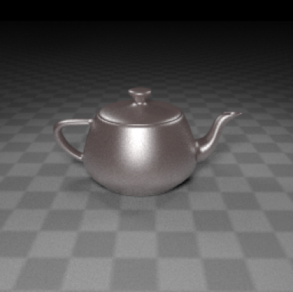

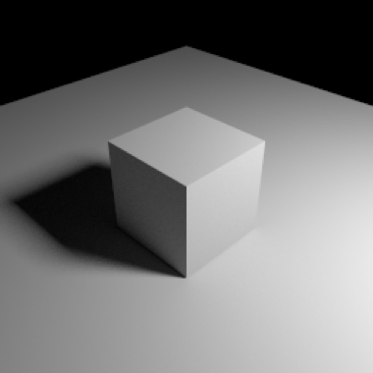
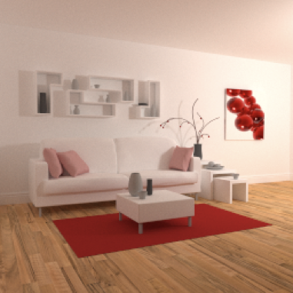
Contributions
This paper proposed a general physically-based differentiable render
glossy reflection
mirror reflection
shadow
global illumination
Notes:
In order to produce photorealistic images, it is important to simulate how lights bounce between the surfaces in the scene.
This paper develops a general, differentiable, physically-based Monte Carlo renderer, where we accurately simulate lighting phenomenon, such as glossy or mirror reflection, shadow, and interreflection between surfaces.

Slide 8
Contributions
This paper proposes a general physically-based differentiable renderer
General differentiable path tracer
a stochastic approach based on Monte Carlo ray tracing to estimate both the integral and the gradients of the pixel filter’s integral
Handling geometric discontinuities
a combination of standard area sampling and novel edge sampling to deal with smooth and discontinuous regions
This paper shows
The utility of proposed differentiable renderer in several applications (inverse rendering, 3D adversarial examples)
Better performance than two previous differentiable renderers
Notes:
There are two key insights of this paper. The first one is to compute the integral and rendering gradients correctly using Monte Carlo sampling. It also handles the geometric discontinuities through a novel edge sampling aaproach. Finally, this paper shows their utility in synthetic data and several real applications such as inverse rendering and producing 3D adversarial examples. It also produces more accurate gradients than two previous differentiable renders.

Slide 9
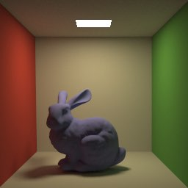
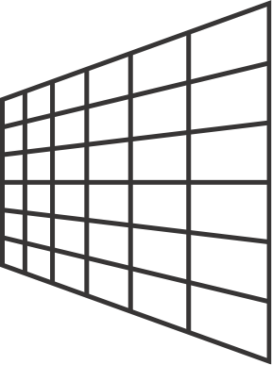
Physically-based Rendering
The Rendering Equation
eye
Notes:
Okay, then let me introduce some background .
The way we do rendering these days, is to randomly sample light paths that go from the light sources to your eyes for each pixel on the image. We will collect many samples per pixel, and take the average of them. This procedure is in essence the rendering equation. Due to time limit, I will not elaborate the details but If you are interested, you to check the last two pages of this slide. I put some equations and useful resources there.
In general, these individual light paths are not differentiable everywhere, because sometimes you hit the bunny and sometimes you hit the walls. However, the average color of these light paths is actually differentiable.

Slide 10
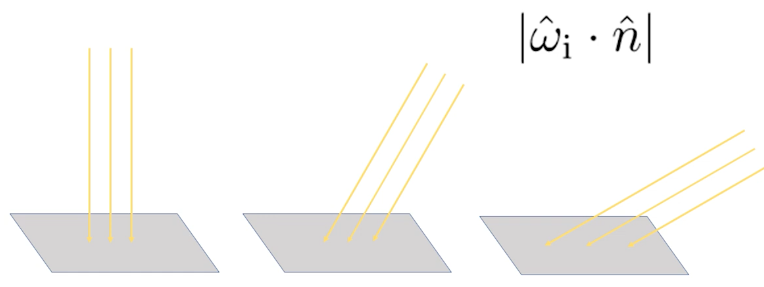
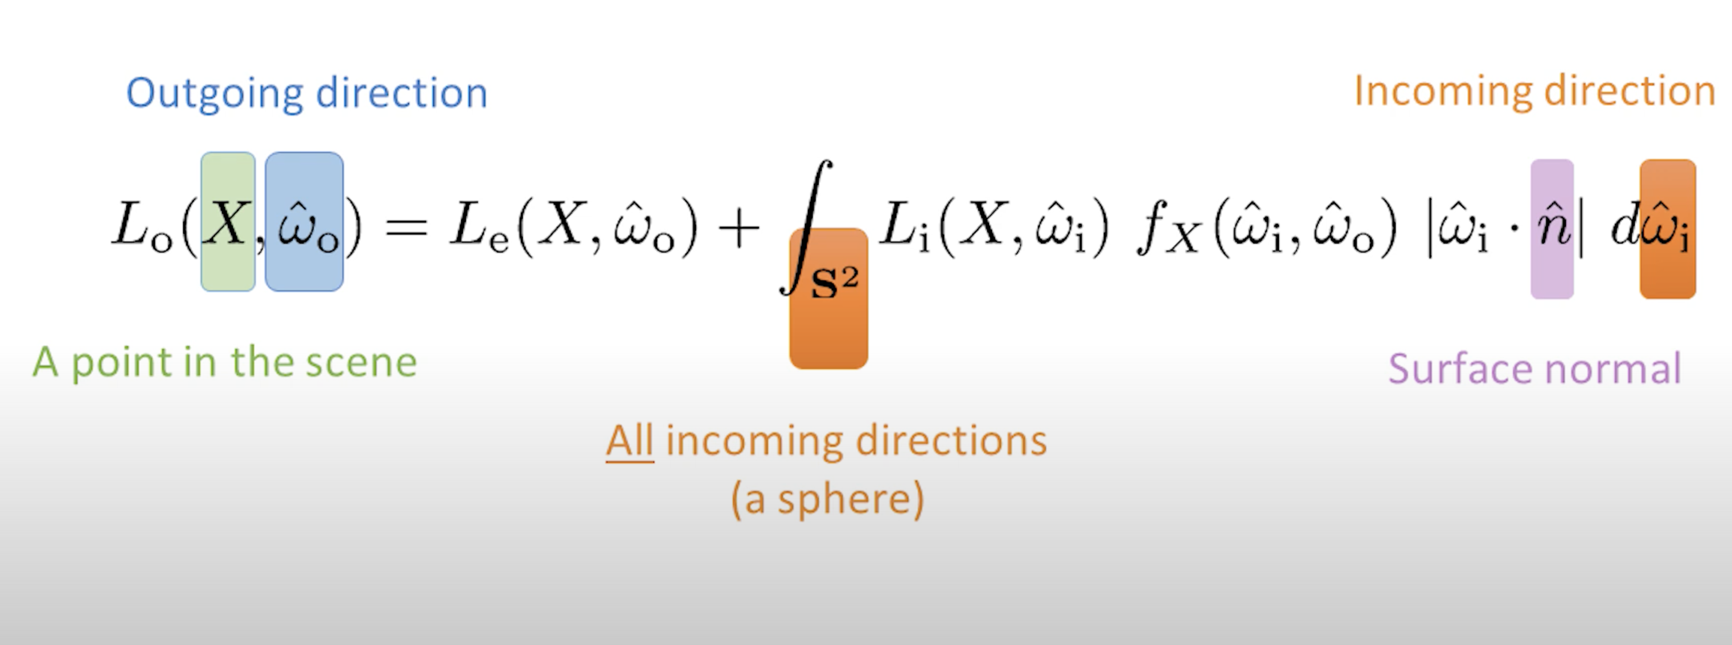
The Rendering Equation
Credit: https://news.developer.nvidia.com/ray-tracing-essentials-part-6-the-rendering-equation/

Slide 11
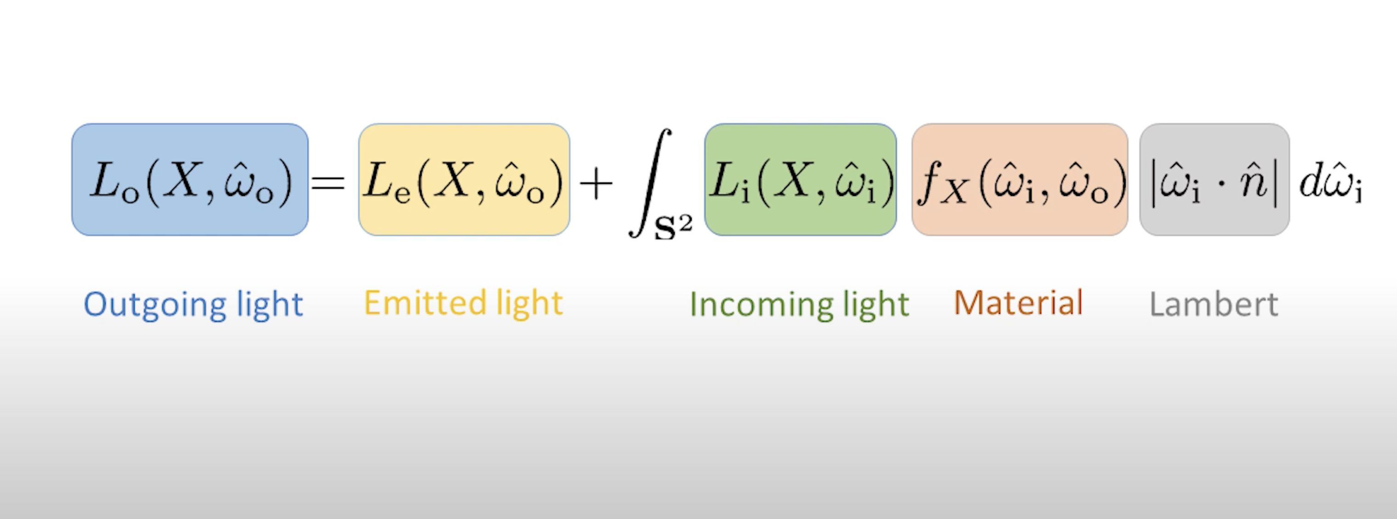
The Rendering Equation
Credit: https://news.developer.nvidia.com/ray-tracing-essentials-part-6-the-rendering-equation/

Slide 12

Rendering = Sampling
color change
when blue triangle
moves up?
pixel
Notes:
To understand it better, let’s focus on one pixel. Assuming there are only two triangles in this pixel to simplify the problem. Usually, there are much more triangles and much more pixels.
However, we don’t know which triangles are in which part of a pixel. What we have are these pink point samples, which corresponds to the light paths I showed before. This is basically the Marte Carlo estimation for the rendering integral.

Slide 13
Key idea: Edge sampling
color change
when blue triangle
moves up?
pixel
Notes:
Therefore the key idea is, in addition to the pink area samples, we also sample the edges of the triangles, so that we can capture the changes at the boundaries. This is basically what they called edge sampling. If we look at the small neighborhood of the edge sample, we will see that the edge sample knows that, after the triangle moves up, it will fall inside the triangle, so there will be more blue, and less white.
This approach can also handle the occlusion case correctly. For example, this sample knows that it hits another triangle, and the small neighborhood around the sample tells them that they should look at the red triangle now

Slide 14
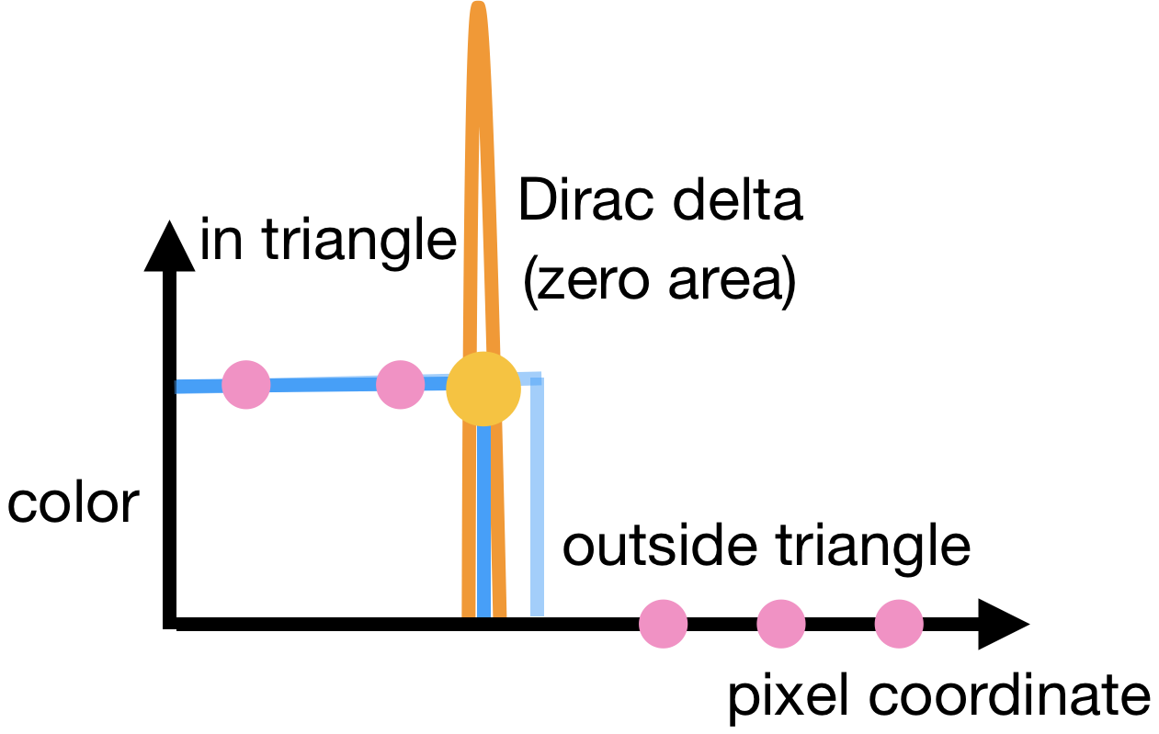
Mathematical formulation
Model each pixel is an integral over the step function
Each pixel is an integral over the step functions
Step function
Dirac delta
Notes:
We need to compute the analytical gradients at these samples. To do this we will need to formulate this idea mathematically. Note that here is a 1D visualization for better understanding. The formulation we will derive is actually 2D and 3D.
Let us start by modelling these triangle edges as step functions. Here the x axis is the pixel coordinate and the y axis is the pixel color. Assume the scene function f is a constant 1. Therefore, each pixel is actually an integral over these step function s. This can be understood either through the rendering equation or intuitively that we are interested in the average color of the light paths that go through the pixel.
Therefore, when we take the gradient of this integral, we obtain the derivative of the step function, which is a Dirac delta function.
Dirac delta is a function that is zero everywhere except at a single point. In this yellow point, it is infinite. It only becomes a real number when you integrate it.
Therefore, when you use these pink area samples to estimate the integral, the problem is that they will always miss the Dirac delta signal, which has zero area. So the edge samples (yellow ones) are explicitly integrating the Dirac delta function.

Slide 15
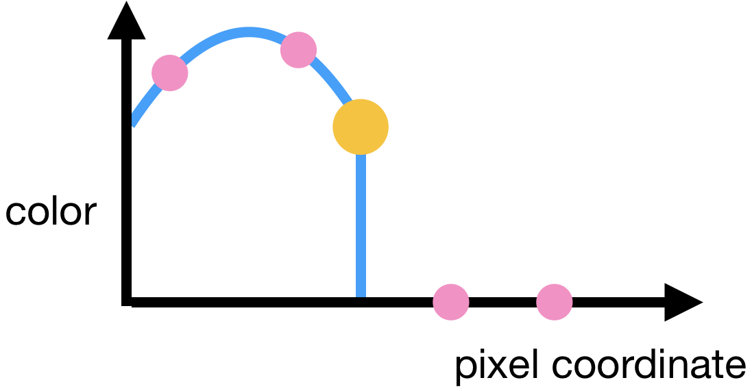
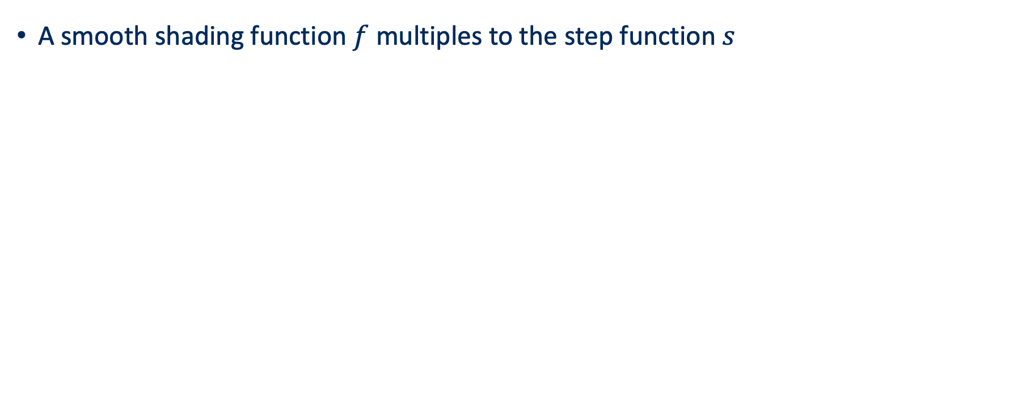
Mathematical formulation
A smooth shading function $f$ multiples to the step function $s$
Dirac delta
Shading derivatives
Notes:
In general, we will have a smooth shading function f multiplies to the step function s.
The shading function f encodes lighting information like the distance falloff of the lighting and the material response.
We also handle the shading derivative correctly, by combining area samples and edge samples. You can see this by applying product rule. The first term, which contains a Dirac delta, can be estimated by the yellow edge samples, while the second term, which is the smooth shading derivative, can be estimated by the pink area samples.
The same idea can be generalized for computing the gradients for shadows and interreflection between surfaces. It is just integrating a different domain, like the area of a light source, or the hemisphere around the shading point, instead of the pixel area.

Slide 16
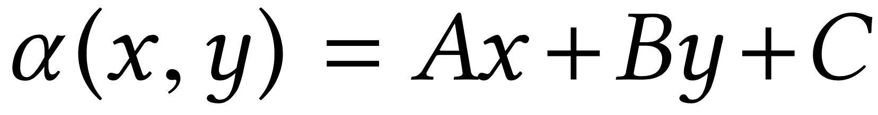
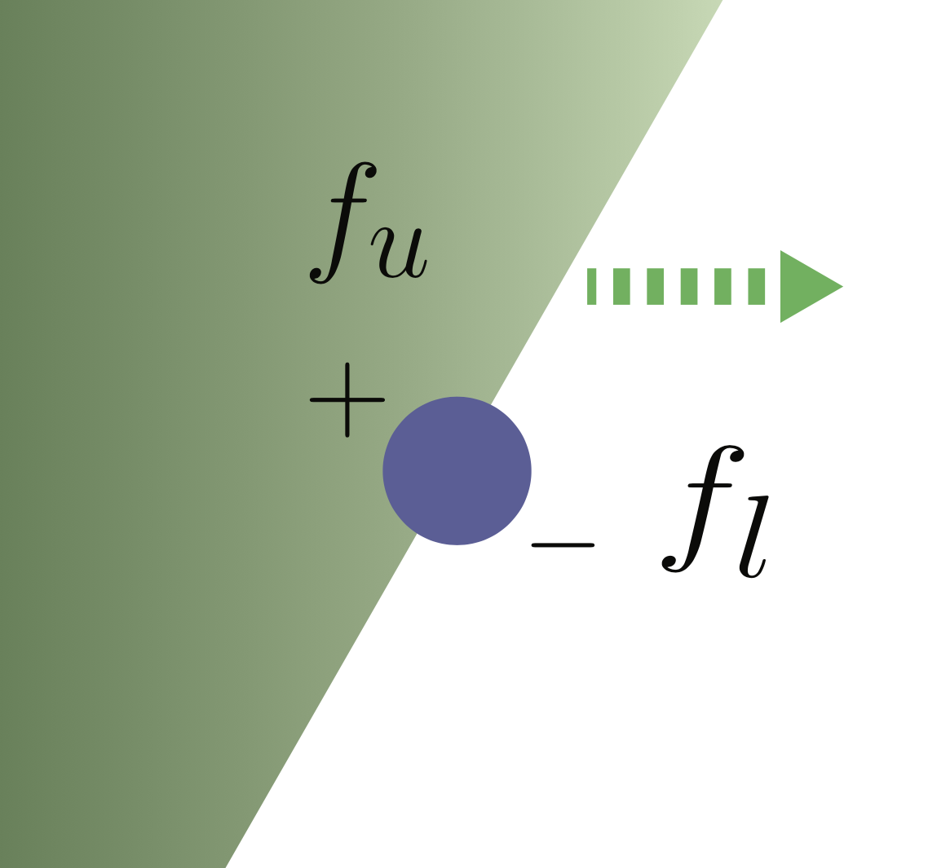
Mathematical formulation
Scene function
Pixel Color
Gradient
All discontinuities happen in the scene edges
Notes:
To recap, when we want to compute the gradients. Traditional area sampling misses the boundary and cannot handle visibility changes. The key idea in this paper is to explicitly sample the Dirac delta signals on the edges.
Let revisit this idea in math. Since all discountinuous happen in the scene edges, let first formulate the edge using alpha function, which is a line or plane. Then we could write the scene function as two parts f_u and f_l, where f_u and f_l are two continuous functions. Then we have this equation for I.

Slide 17
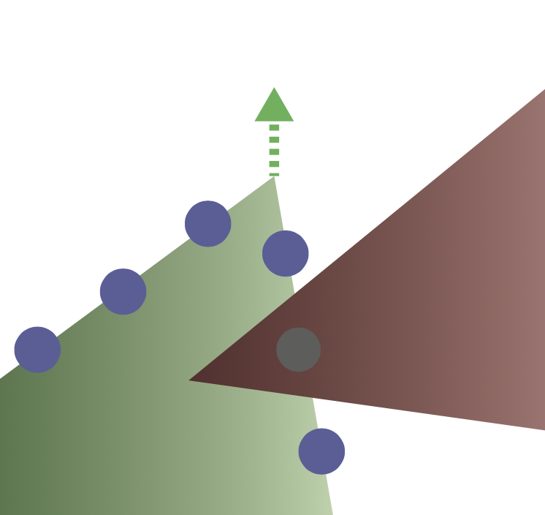

Mathematical formulation
Using the Chain rule
Edge sampling
Area sampling
Notes:
Then taking the derivative and using the chain rule, we have the following equation. The first term includes a delta function, which can be approximated using edge sampling. Tecond term is just the gradients of smooth f function, which can be calculated using tradiction area sampling and auto-differentiation.
Okay, so far do you have any questions for the formation?

Slide 18
Mathematical formulation
Using the Chain rule
Edge sampling
Area sampling
Notes:
we eliminate the Dirac function by performing variable substitution to rewrite the first term containing the Dirac delta function to an integral that integrates over the edge, that is, over the regions where αi (x,y) = 0

Slide 19
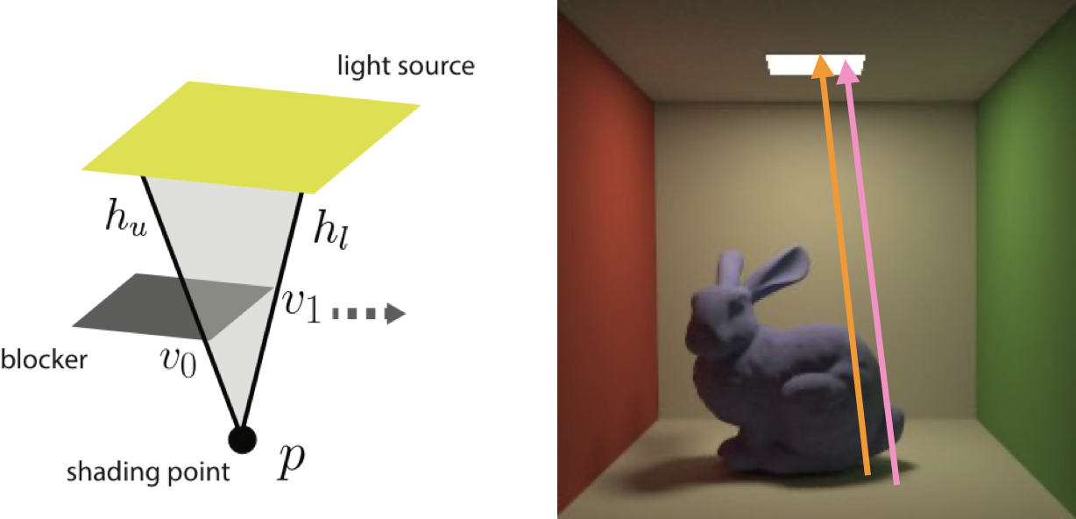
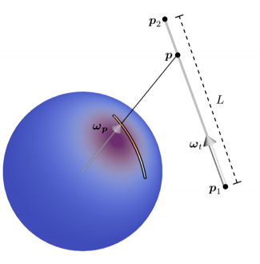
Generalization & Scalability
Generalizable to shadow & interreflection
Use importance sampling to sample edges and pick points (Hill and Heitz 2017)
select an edge & pick a point
area of a light source
Notes:
we eliminate the Dirac function by performing variable substitution to rewrite the first term containing the Dirac delta function to an integral that integrates over the edge, that is, over the regions where αi (x,y) = 0

Slide 20
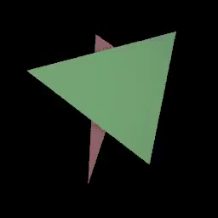

Experiments – Synthetic examples
Optimizing 6 triangle vertices
Source
Target
Notes:
Cool, let us take a look at the experiments. They first verify their approach on several synthetic scenes, which cover a variety of effects, including occlusion, non-Lambertian materials, and global illumination. Specifically, they try to match the scene parameters of a synthetic image by updating the scenes parameters.
In first example, the goal is to update the vertices of two triangles to match the target. From the video, we know this approach can handle the occlusion correctly.

Slide 21
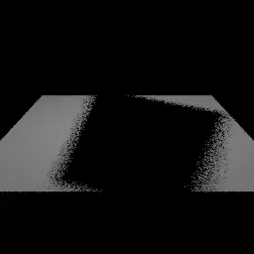
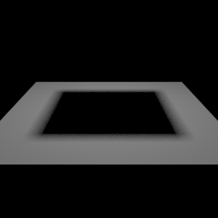
Experiments – Synthetic examples
Optimizing blocker vertices
Source
Target
Notes:
Cool, let us take a look at the experiments. They first verify their approach on several synthetic scenes, which cover a variety of effects, including occlusion, non-Lambertian materials, and global illumination. Specifically, they try to match the scene parameters of a synthetic image by updating the scenes parameters.
In first example, the goal is to update the vertices of two triangles to match the target. From the video, we know this approach can handle the occlusion correctly.

Slide 22
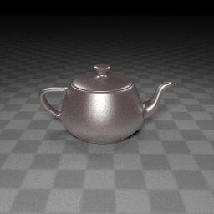

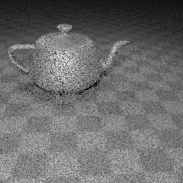
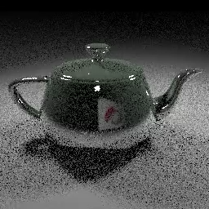
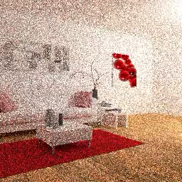
Experiments – Synthetic examples
camera & teapot material
logo translation
camera
Target
Source
Notes:
The second example is to optimize for the triangle vertices of a shadow blocker. Note that the images in the optimization procedure are more noisy because they use less samples. This is because they need to render the image many times during optimization, so using less samples will speed up the process.
Similarly, they can optimize other parameters such as camer pose and material parameter.

Slide 23
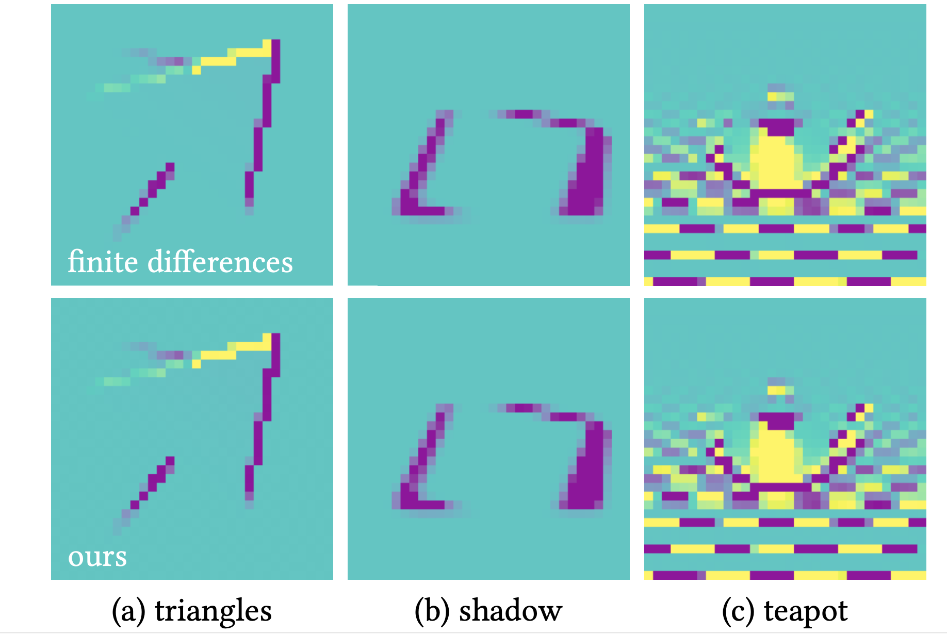
Experiments – Synthetic examples
Compare with central finite differences (32 x 32 scenes)

Slide 24
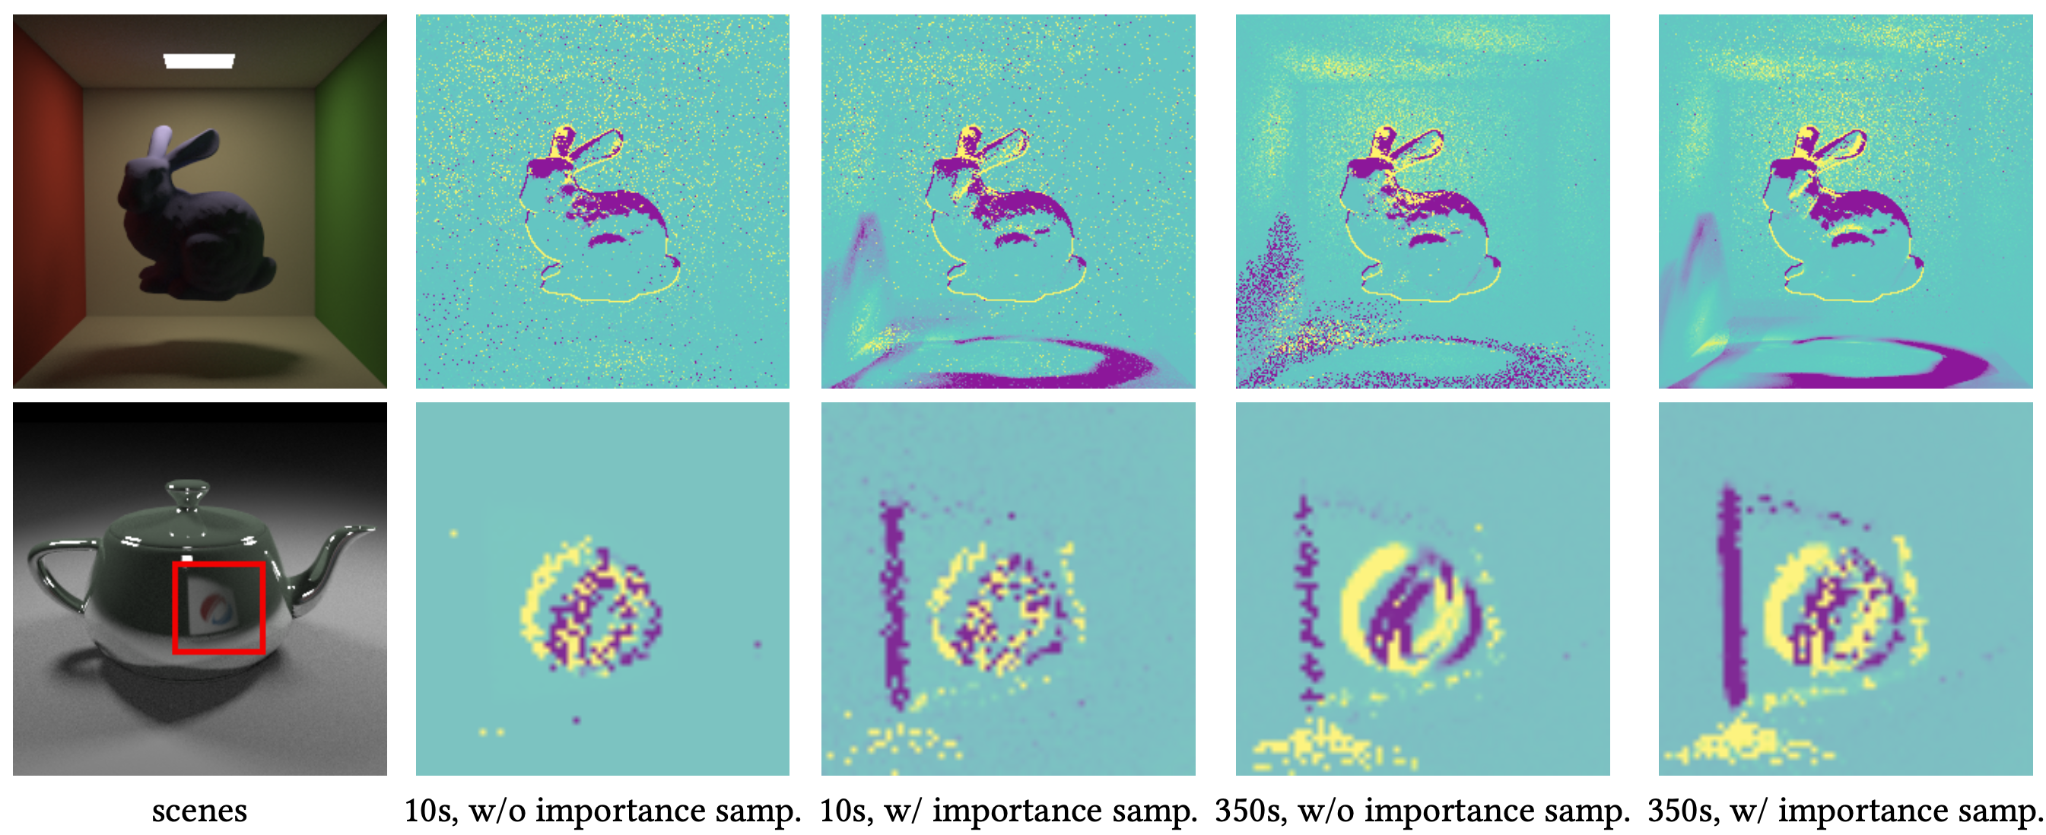
Experiments – Synthetic examples
Sampling with or without edge importance sampling

Slide 25

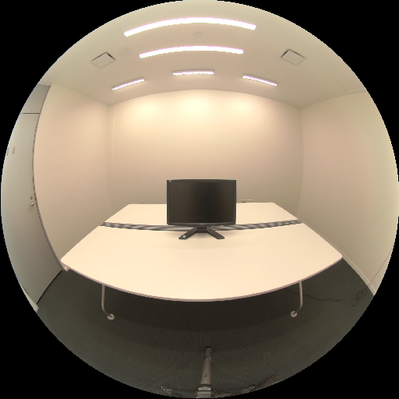

Experiments – Inverse rendering
Optimizing camera pose, light emission and materials
initial guess
target
reconstructed
Notes:
Apart from sythetic examples. They also evaluate their method on a real photograph. At the center is a photo of a room. Someone manually modeled the scene and we tried to recover the camera pose, the brightness of the light sources, and reflectance, roughness of the objects.
We can see that the reconstructed scenes match reasonably with the target. It is not perfect but it does a reasonable job.

Slide 26

Experiments – Inverse rendering
Optimizing camera pose, light emission and materials
optimization
target
Notes:
Here is the optimization process. Note that they render the early iterations in lower resolution to avoid trapping in local minimum.

Slide 27
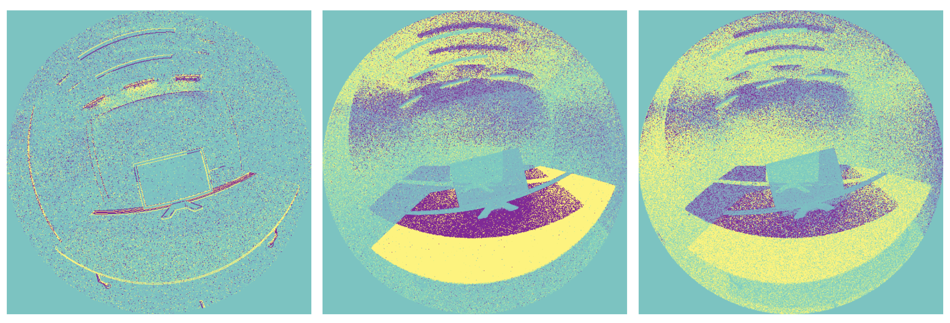
Experiments – Inverse rendering
Optimizing camera pose, light emission and materials
camera gradient
table albedo gradient
light gradient
Notes:
Here are the visualizations of gradients writh respect to different scene parameters such as camer and light. It shows that the proposed render could produce reasonable gradients that capture the boundaries of the scenes.

Slide 28
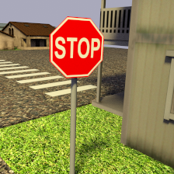
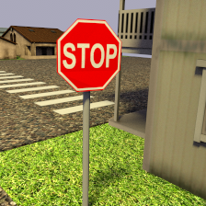
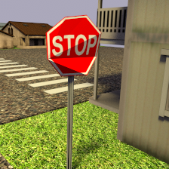
Experiments – 3D adversarial examples
Optimizing vertex position, camera pose, light intensity, position
VGG 16:
53% street sign
6.7% handrail
5 iterations:
26.8% handrail
20.2% street sign
25 iterations:
23.3% handrail
3.4% street sign
Notes:
They also use the gradients of a renderer to produce 3D adversarial examples. Here we optimize for around 2000 parameters including vertex positions, camera pose, light intensity, and position. We render this image and throw it to a popular neural network. The network says it’s probably a street sign. Probably not a handrail.
They try to reduce the street sign probability using gradients. After five iterations, the network starts to think it’s both probable that it’s a handrail and a street sign. After 25 iterations, the network thinks it’s probably not a street sign.

Slide 29

Limitations
Performance (rendering speed & large variance):
Edge sampling and auto differentiation are slow (bottleneck)
It is a challenging task to find all object edges and sampling them
A few hundreds of milliseconds to generate a small image (256x256) with a small number of samples (4)
Assumptions:
Mesh
Interpenetrating geometries and parallel edges
Shader discontinuities
Motion blur
Notes:
When two triangles are penetrating each other, there will be an extra edge that we don’t take into consideration. This can be solved by splitting the triangles in a preprocessing step but we haven’t implemented it yet.
There is also a pathological case when two edges are perfectly aligned to a viewport, we will miss the occluded edge. It’s fine when they are not perfectly aligned, so this rarely happens.
This paper doesn’t deal with the motion blur and it requires handling 4D edges.

Slide 30
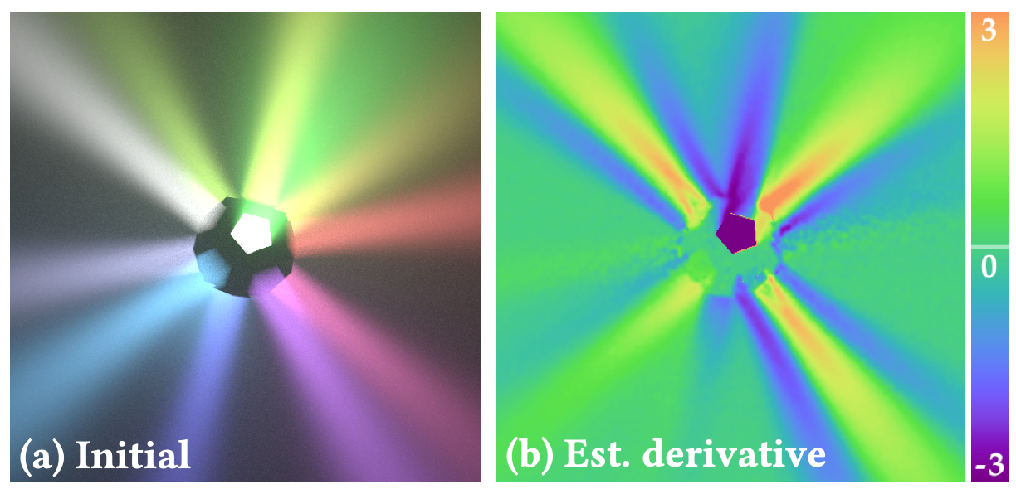
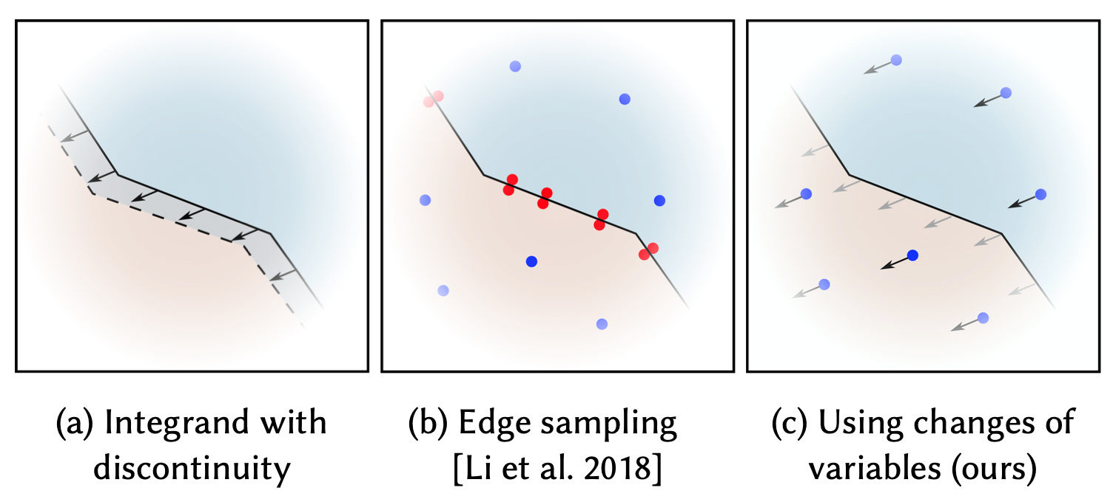
Follow-up works
Addressing the discontinuity problem in the rendering equation
Handle volumetric light transport (Zhang et al., 2019)
Re-parameterize the integral (Loubet et al., 2019)

Slide 31
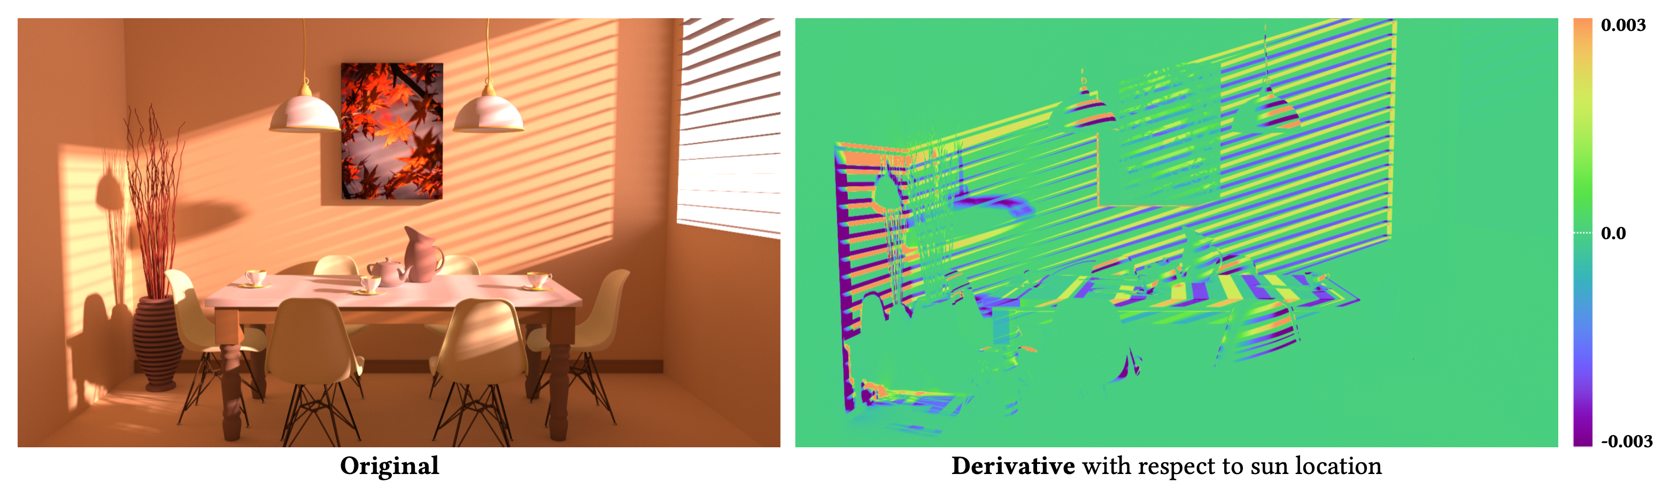
Follow-up works
Estimate the derivatives of the path integral formulation
Path space differentiable rendering (Zhang et al., 2020)

Slide 32
Contributions (recap)
Previous works
Differentiable rendering that targets specific cases (faces, hands, etc.) => hard to generalize
Fast, approximate general renderers (OpenDR, Neural Mesh Rendering) => simplified models
challenges: estimating the derivative corresponding to the integral of the rendering equation
This paper proposes a general physically-based differentiable renderer
General differentiable path tracer
Handling geometric discontinuities
This paper shows
The utility of proposed differentiable renderer in several applications (inverse rendering, 3D adversarial examples)
Better performance than two previously proposed differentiable renderers

Slide 33
References
Differentiable Monte Carlo Ray Tracing through Edge Sampling. Li et al., 2018.
Slides for “Differentiable Monte Carlo Ray Tracing through Edge Sampling”. Li et al., 2018.
Differentiable Ray Tracing. Novello. https://sites.google.com/site/tiagonovellodebrito/diffrt.
Differentiable Rendering: A Survey. Kato et al., 2020.
Ray Tracing Essential Part 6: The Rendering Equation. https://news.developer.nvidia.com/ray-tracing-essentials-part-6-the-rendering-equation/

